Slide 1
MARKETING ANALYTICS
Introduction

Slide 2
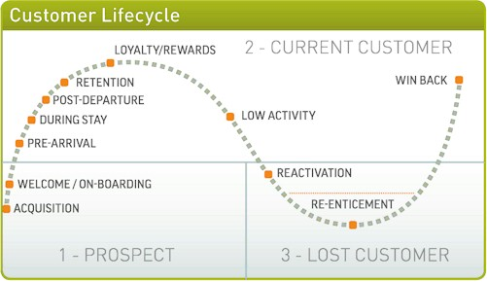
Marketing Analytics

Slide 3
Trends Driving Marketing Analytics Adoption
Accountability
Online Data Availability
Marketing
Analytics
Adoption
Data-Driven Presentations
Reduced Resources
Massive Data

Slide 4
Trends Driving Marketing Analytics Adoption
Accountability
Online Data Availability
Improve productivity
Reduce costs
“What gets measured gets done”
Marketing
Analytics
Adoption
Cloud-based data storage
Online = speed
Online = convenience
Data-Driven Presentations
Reduced Resources
Data to back up proposals
Predict success of plans
Massive Data
Do more with less
Scrutinized budgets
Marketers must show outcomes
Initiatives to capture customer information
What to do with all that data?
Before:
Huge budgets
Now:
Tiny budgets

Slide 5
Marketing Analytics Advantages
Drive Revenue
Persuade Executives
Marketing
Analytics
Advantages
Save Money
Side-step Politics
Encourage Experimentation

Slide 6
Marketing Analytics Advantages
Drive Revenue
Persuade Executives
Marketing as cost center
Marketing as profit center
Correlation between spending and results
Marketing
Analytics
Advantages
Focus on revenue impact from marketing
Correlation between spending & results
Save Money
Side-step Politics
Old way: Execute campaign → guess outcome
No longer tolerate such an approach
New way: Predict outcome
Some CEOs do not appreciate marketing
Show impact of efforts with metrics
Encourage Experimentation
Test multiple scenarios before proceeding
Run simulations
Predict which will work best

Slide 7
Models: What is a Model?
Topic Description
Model Simplified representation of reality to solve problems
Example: Advertising effectiveness model
Purpose Evaluate impact of input variables
Example: Assess how advertising affects sales
Decisions Models provide guidance on marketing actions
Example: Decide on ad budget to achieve objectives
A
Sales
Advertising Effectiveness:
Response (sales revenue)
increases with increasing ad budget
until Point A, then decreases
time
Advertising

Slide 8
Models: Verbal, Pictorial, Mathematical
Topic Description
Verbal Expressed in words
“Sales is influenced by advertising”
Pictorial Expressed in pictures
Chart or graph of phenomenon
Mathematical Expessed in equation
Sales = a + b * Advertising
Verbal
Pictorial
Mathematical
Sales = f(advertising)

Slide 9
Models: Forms
Topic Description
Descriptive Characterize (describe) marketing phenomenon
Identify causal relationships and relevant variables
Predictive Determine likely outcomes given certain inputs
Classic “What If?” spreadsheet exercise
Prescriptive Decide best course of action to maximize objective,
given limits on input variables (constrained optimization)
“Given X, what should I do?”
Descriptive
Predictive
Prescriptive
Sales
This Way
Advertising

Slide 10
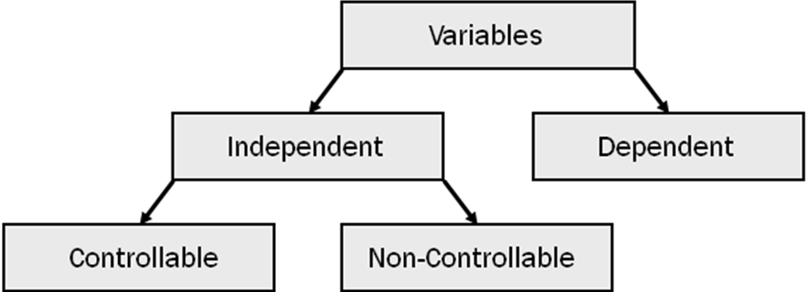
Models: Variables
Topic Description
Variable Quantity that can be changed, or varied
Independent Variable Variable whose value affects dependent variable (x)
Dependent Variable Variable representing marketing objective (y, or output)

Slide 11
Models: Terminology
Linear Response Model
Y (Sales)
Dependent
Variable
Y = a + b * X
Y = Sales (Dependent Variable) (Output)
a = Parameter: Y-intercept
b = Parameter: Slope
x = Advertising (Independent Variable) (Input)
b
Y-intercept
(Sales level
when
advertising
spending =0)
1
Slope = rise/run = b/1
X (Advertising)
Independent Variable

Slide 12
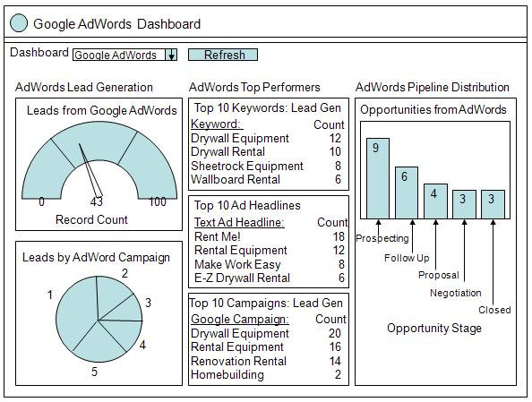
Metrics
Topic Description
Definition Business-oriented key performance indicators
Examples: Sales per channel, Cost per sale
Purpose Monitor and improve marketing effectiveness
Take corrective action as necessary
Example: Marketing expense as percentage of sales
Metrics Families Groups of control metrics; Diagnostic & predictive info
Example: Sales metrics: sales/industry; sales/product
Metrics Dashboards Marketing automation systems
- Marketo
Salesforce automation systems
- Salesforce.com
Metrics Dashboard

Slide 13
Topics
Pricing
Customer Segmentation
Predicting Customer Response
Developing Customers
Retaining Customers

